Slide 1



Progetto per il corso di Metodi Quantitativi Per L’Informatica:
Confronto tra le reti Darknet Yolo e Faster-RCNN
Marco Costa, 1691388
Notes:
1

Slide 2
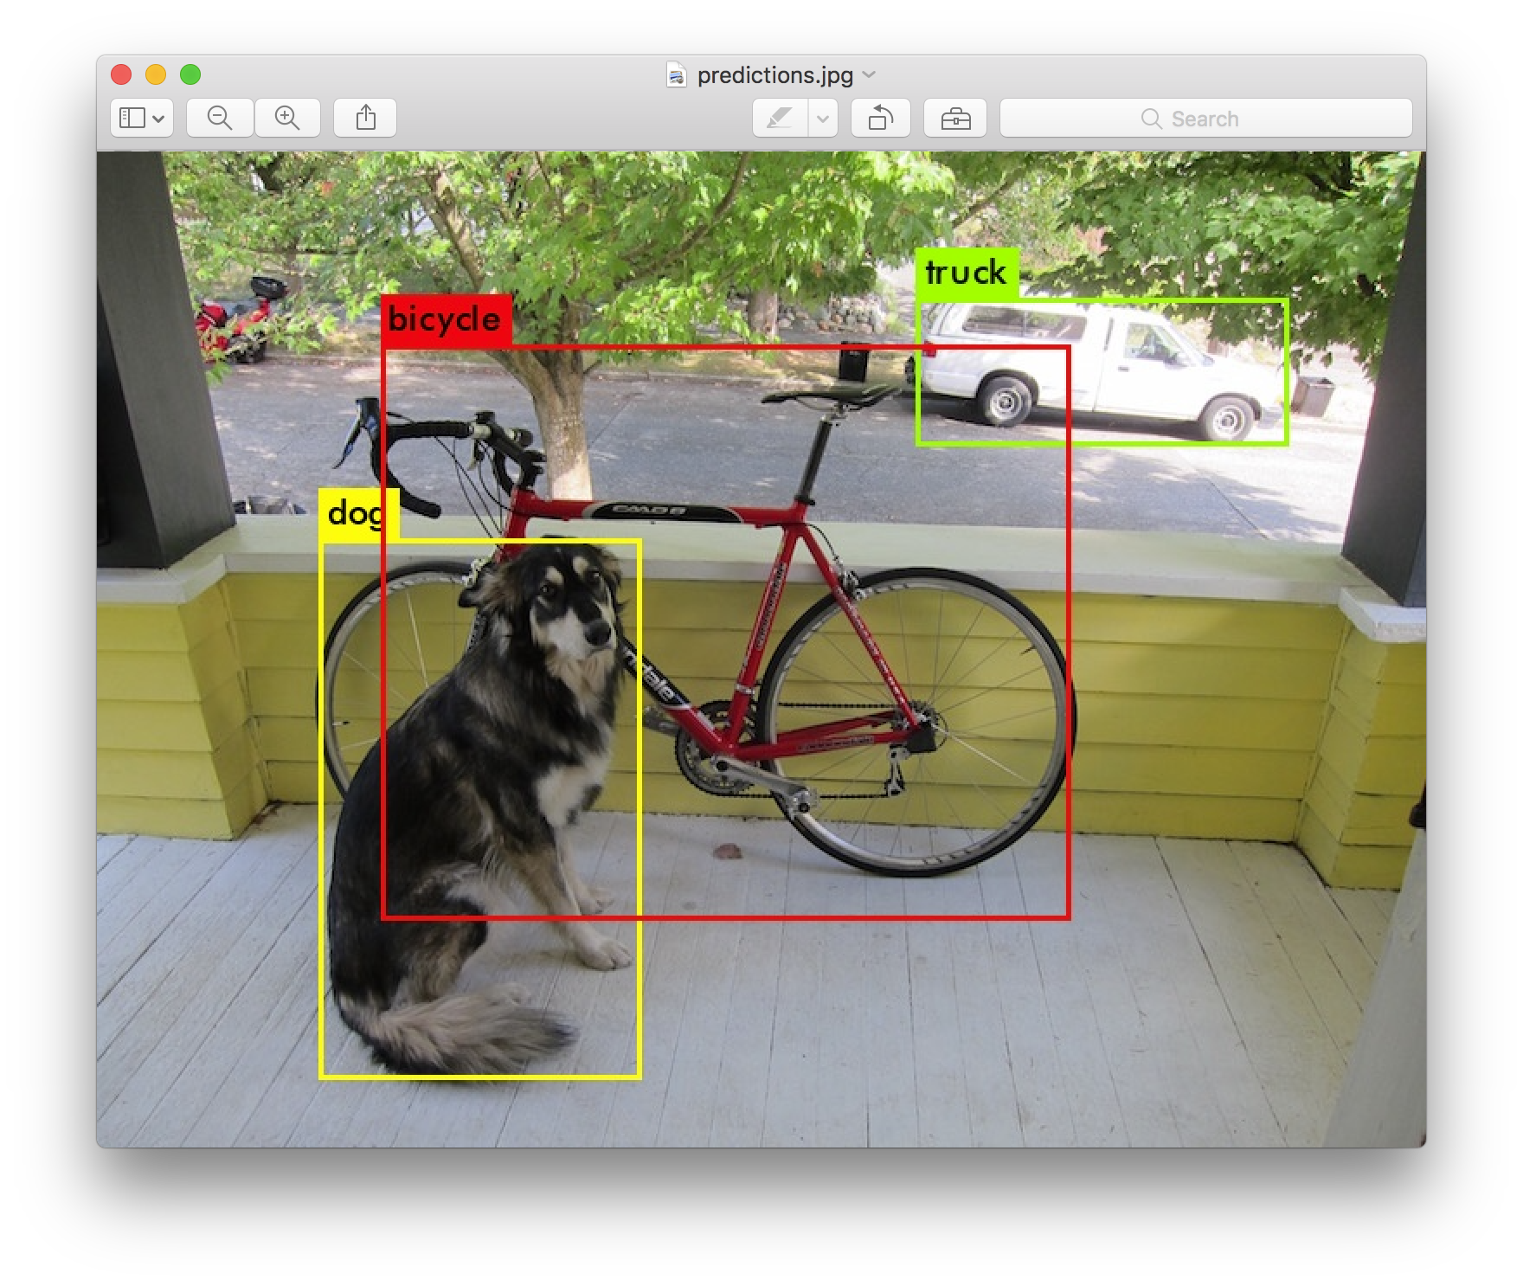
PURPOSE OF THE PROJECT
Compare two different types of Neural Networks on image detection:
Darknet YOLO Vs. Faster-RCNN
Marco Costa, 1691388
2
Notes:
2

Slide 3
HARDWARE SPECIFICATIONS
CPU: Intel Core i7-4720HQ (2.60-3.60 GHz, 6MB Cache
GPU: Nvidia GeForce GTX 950M (4096MB DDR3)
RAM: 16 GB (DDR3L 1600 MHz SDRAM)
STORAGE: SSD 525 GB + HDD 1000 GB
OS: Ubuntu 16.04.04 with CUDA Toolkit 8.0 and cuDNN 7.0
Marco Costa, 1691388
3

Slide 4
Darknet YOLO
YOLO (You Only Look Once) is a real-time object detection system that uses neural networks to detect objects in images. It is written in C.
Marco Costa, 1691388
4

Slide 5
How does it work:
Marco Costa, 1691388
5

Slide 6
Advantages:
It looks at the whole image at test time so its predictions are informed by global context in the image;
It also makes predictions with a single network evaluation unlike systems like R-CNN which require thousands for a single image;
This makes it extremely fast, more than 1000x faster than R-CNN and 100x faster than Fast R-CNN.
Marco Costa, 1691388
6

Slide 7
Architecture:
Marco Costa, 1691388
7

Slide 8
Faster-RCNN
It is written in Python and Caffe.
Marco Costa, 1691388
8

Slide 9
How does it work:
Faster R-CNN has two networks: region proposal network (RPN) for generating region proposals and a network using these proposals to detect objects.
Some operations execute on the CPU in Python layers.
RPN ranks region boxes (called anchors) and proposes the ones most likely containing objects.
Marco Costa, 1691388
9

Slide 10
Architecture:
Region Proposal Network
Region of Interest (RoI) Pooling
R-CNN module
Marco Costa, 1691388
10

Slide 11
MY EXPERIMENT
Marco Costa, 1691388
11

Slide 12
Run Darknet YOLO on Pascal VOC 2007 Test Set with threshold=0.8;
Run Faster-RCNN on Pascal VOC 2007 Test Set with threshold=0.8;
Run Darknet YOLO on Pascal VOC 2007 Test Set with threshold=0.2;
Run Faster-RCNN on Pascal VOC 2007 Test Set with threshold=0.2;
Run Darknet YOLO on COCO 2017 Test Set with threshold=0.8;
Run Faster-RCNN on COCO 2017 Test Set with threshold=0.8;
Run Darknet YOLO on COCO 2017 Test Set with threshold=0.2;
Run Faster-RCNN on Pascal COCO 2017 Test Set with threshold=0.2.
OSS: Only the first 1000 images for both the sets.
Marco Costa, 1691388
12

Slide 13
DETECTION THRESHOLD
What is threshold?
How does it affect the output?
Marco Costa, 1691388
13

Slide 14
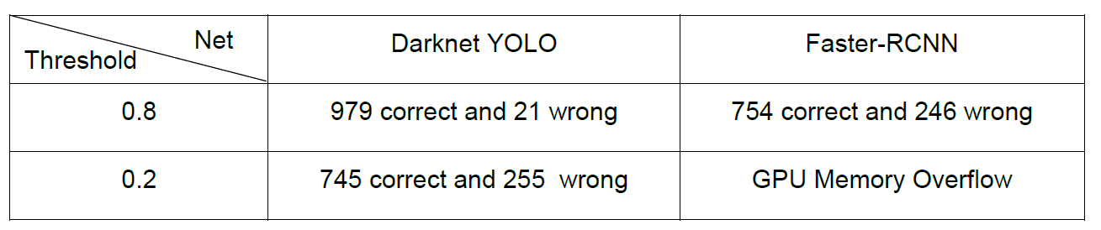
Running both the nets on Pascal VOC 2007 Test Set:
Marco Costa, 1691388
14

Slide 15
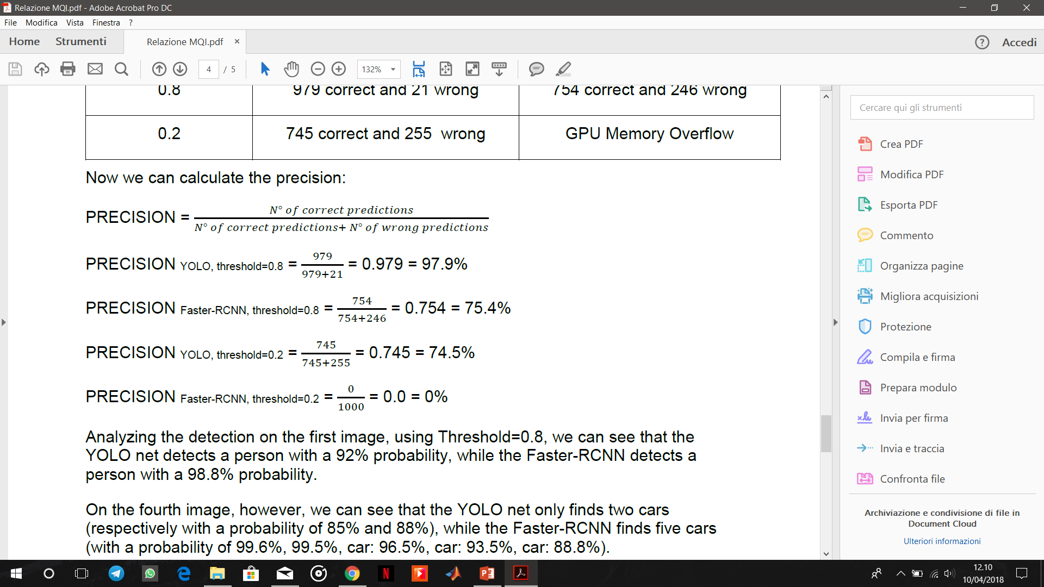
PRECISION OF THE NETS:
Marco Costa, 1691388
15

Slide 16
Results
Marco Costa, 1691388
16

Slide 17
Comparing some outputs:
Detection of both the nets on:
Images 000001.jpg and 000004.jpg of Pascal VOC 2007 Test Set;
Images 000000000001.jpg and 000000000016.jpg of COCO 2017 Test Set.
Marco Costa, 1691388
17

Slide 18
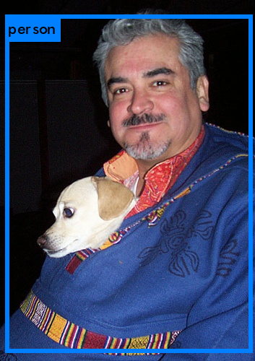
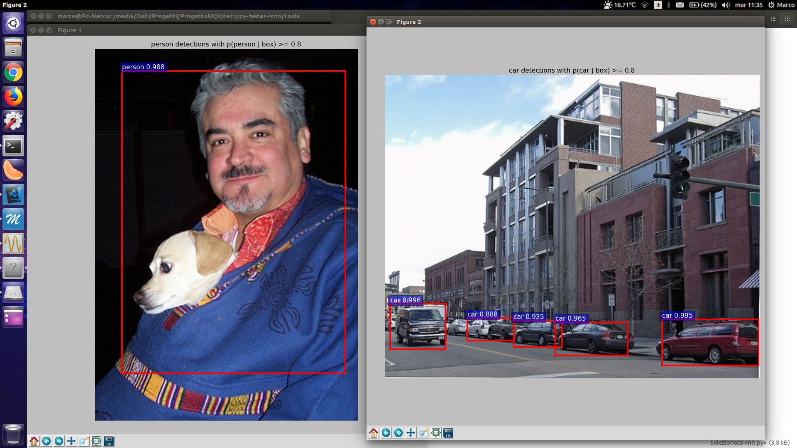
000001.jpg
person: 92%
person: 98.8%
Marco Costa, 1691388
18

Slide 19
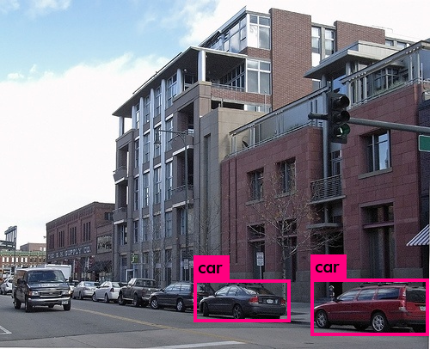
000004.jpg
car: 85%
car: 88%
car: 99.6%
car: 99.5%
car: 96.5%
car: 93.5%
car: 88.8%
Marco Costa, 1691388
19

Slide 20
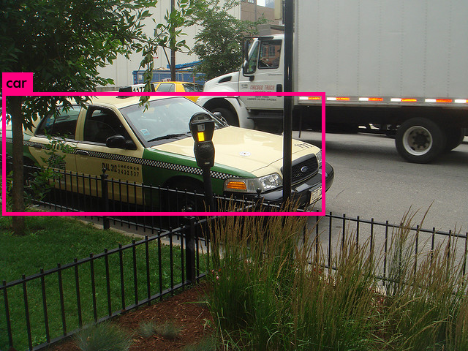
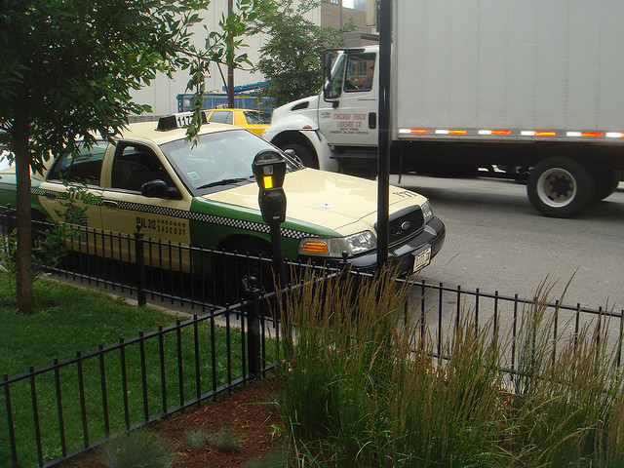
000000000001.jpg
car: 90%
Marco Costa, 1691388
20

Slide 21
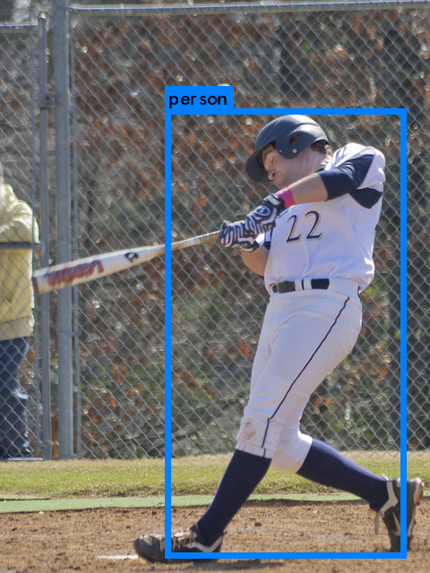
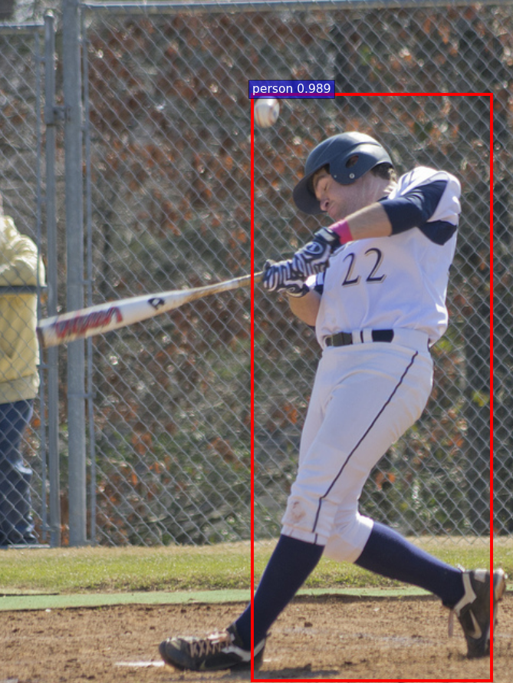
000000000016.jpg
person: 94%
person: 98.9%
Marco Costa, 1691388
21

Slide 22
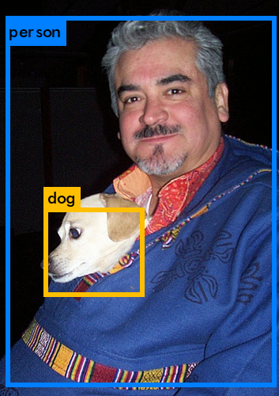
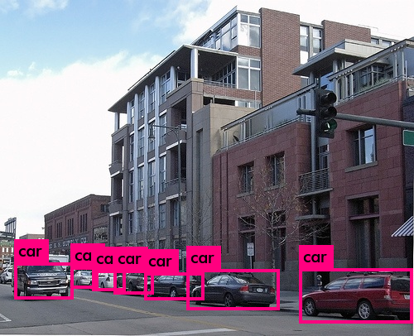
Darknet YOLO (Threshold=0,2)
000004.jpg
car: 80%, car: 48%, car: 54%, car: 78%,
car: 76%, car: 85%, car: 88%
000001.jpg
person: 92%, dog: 28%
Marco Costa, 1691388
22

Slide 23
Darknet YOLO Vs. Faster-RCNN Use of Hardware Resources:
Darknet YOLO use of GPU
Faster-RCNN use of GPU
Marco Costa, 1691388
23

Slide 24
Darknet YOLO Vs. Faster-RCNN Time:
Pascal VOC 2007 Test Set
COCO 2017 Test Set
Darknet YOLO
0.8
2m:23s (92s)
2m:50s (92s)
0.2
2m:23s (91s)
3m:7s (91s)
Faster-RCNN
0.8
24m:23s (163s)
12m:49s (159s)
0.2
GPU Memory Overflow
GPU Memory Overflow
Marco Costa, 1691388
24

Slide 25
CONCLUSIONS
The Darknet YOLO net is more precise than the Faster-RCNN;
The first network requires less hardware resources than the second one (1028MB vs 3497MB of GPU Memory with Treshold=0.8, Faster-RCNN causes GPU Memory overflow with Treshold=0.2);
The Darknet YOLO net takes much less time than the Faster-RCNN;
The Faster-RCNN has a better accuracy than the Darknet YOLO net.
Marco Costa, 1691388
25

Slide 26
REFERENCES
Darknet Yolo - YOLO: Real-Time Object Detection (https://pjreddie.com/darknet/yolo)
Faster-RCNN - ZF model (https://github.com/rbgirshick/py-faster-rcnn)
Marco Costa, 1691388
26

